Slide 1
Chapter 10b
SHA-3 or: The Hash Function Keccak
ver. Jun 18, 2013
These slides were prepared by Christof Paar

Slide 2
Some legal stuff (sorry): Terms of Use
The slides can used free of charge. All copyrights for the slides remain with Christof Paar and Jan Pelzl.
The title of the accompanying book “Understanding Cryptography” by Springer and the author’s names must remain on each slide.
If the slides are modified, appropriate credits to the book authors and the book title must remain within the slides.
It is not permitted to reproduce parts or all of the slides in printed form whatsoever without written consent by the authors.
Chapter 9b of Understanding Cryptography by Christof Paar and Jan Pelzl

Slide 3

Content of this Chapter
Chapter 9b of Understanding Cryptography by Christof Paar and Jan Pelzl

Slide 4
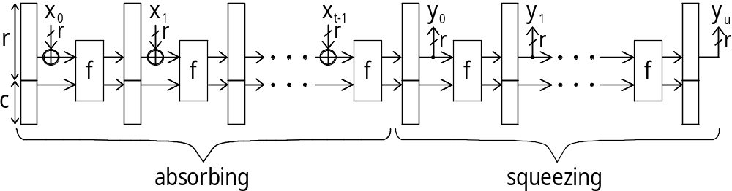
Fig.. 1.2 Absorbing and squeezing phase of Keccak
Chapter 9b of Understanding Cryptography by Christof Paar and Jan Pelzl

Slide 5
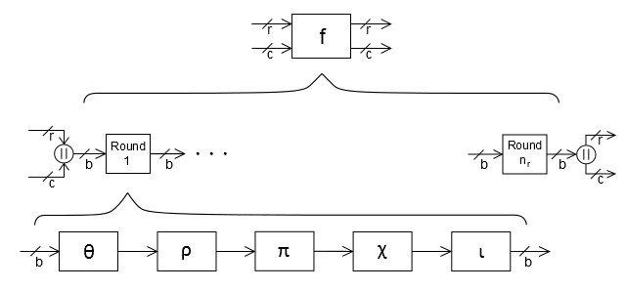
Fig. 1.3 The internal structure of Keccak
Chapter 9b of Understanding Cryptography by Christof Paar and Jan Pelzl

Slide 6
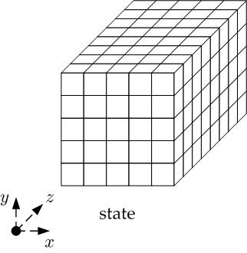
Fig. 1.4 The state of Keccak
Chapter 9b of Understanding Cryptography by Christof Paar and Jan Pelzl

Slide 7
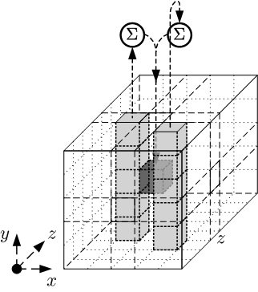
Fig. 1.5 The Theta Step of Keccak – visually
Chapter 9b of Understanding Cryptography by Christof Paar and Jan Pelzl

Slide 8
Fig. 1.5 The Theta Step of Keccak – pseudo code
Input: state array A[x,y]
Output: manipulated state array A[x,y]
C[x] = A[x,0] ⊕ A[x,1] ⊕ A[x,2] ⊕ A[x,3] ⊕ A[x,4] x = 0…4
D[x] = C[x-1] ⊕ rot(C[x+1],1) x = 0…4
A[x,y] = A[x,y] ⊕ D[x] x,y = 0…4
Chapter 9b of Understanding Cryptography by Christof Paar and Jan Pelzl

Slide 9
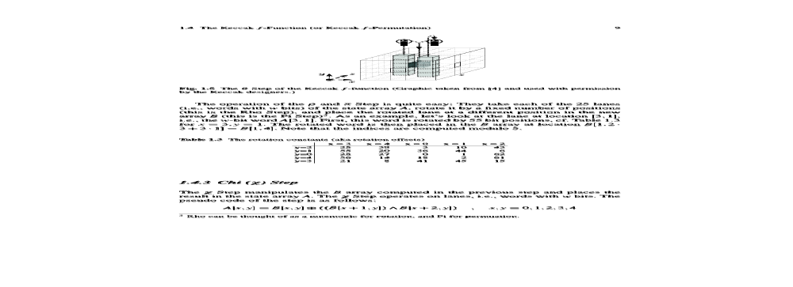
Table 1.3 The rotation constants of Keccak
Chapter 9b of Understanding Cryptography by Christof Paar and Jan Pelzl

Slide 10
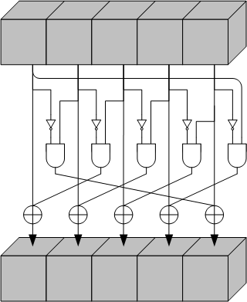
Fig. 1.6 The Chi Step of Keccak
Chapter 9b of Understanding Cryptography by Christof Paar and Jan Pelzl

Slide 11
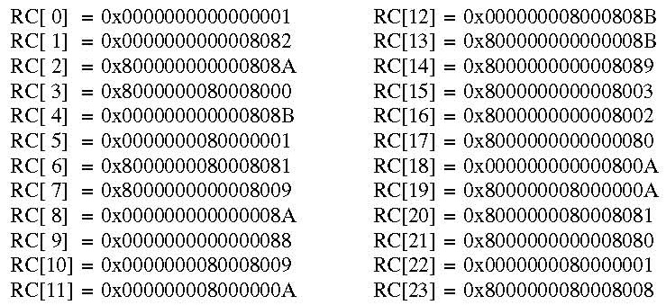
Table 1.4 The round constants of Keccak
Chapter 9b of Understanding Cryptography by Christof Paar and Jan Pelzl

